Slide 1

College Open Events
2024 - 2025

Slide 2
Check the college websites and register.
Visit as many colleges as possible to help make the best decision for you.

Slide 3

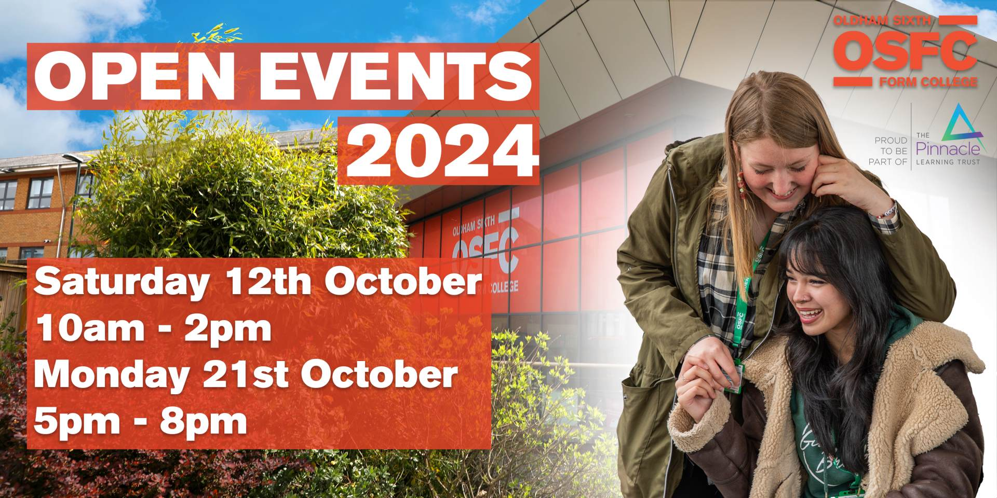

Slide 4

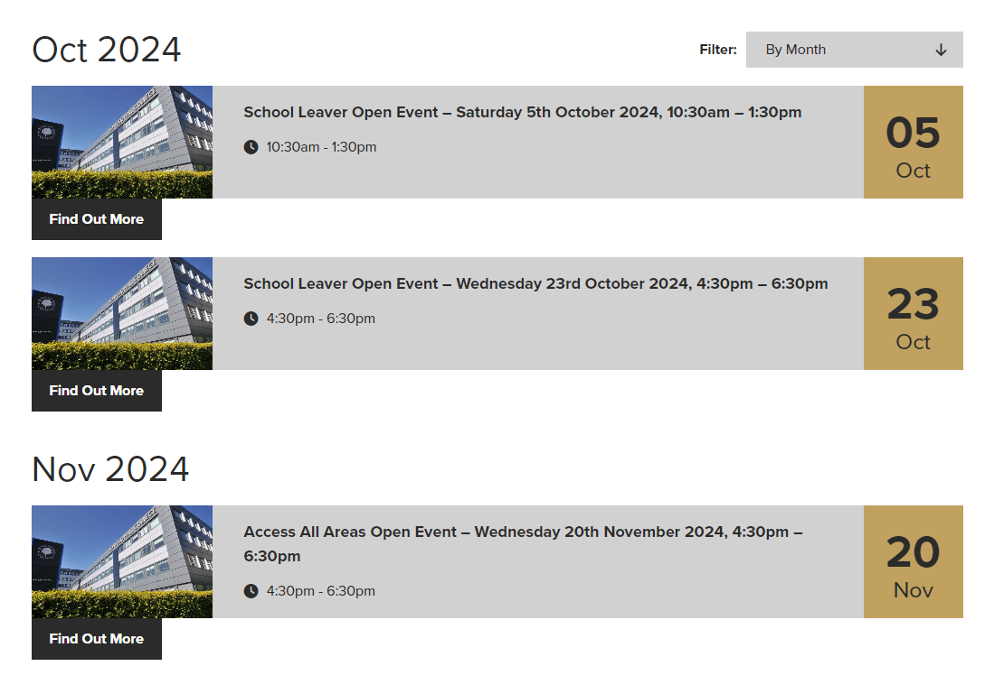
HOPWOOD HALL COLLEGE

Slide 5

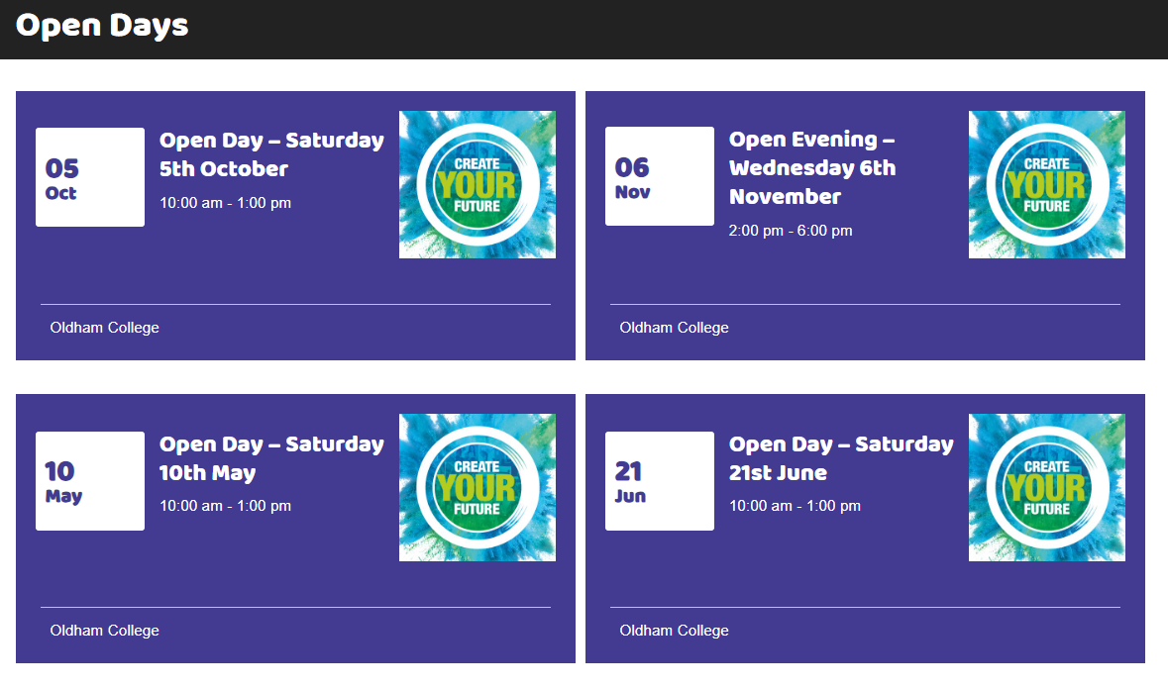
THE OLDHAM COLLEGE - VOCATIONAL COURSES

Slide 6



Slide 7

OPEN EVENTS
SATURDAY
3RD OCTOBER
WEDNESDAY
16TH NOVEMBER

Slide 8
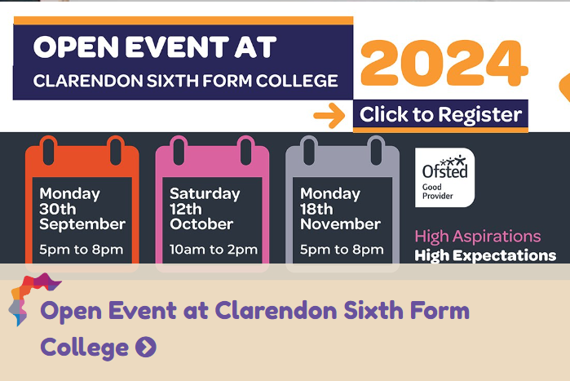

Slide 9


Slide 10
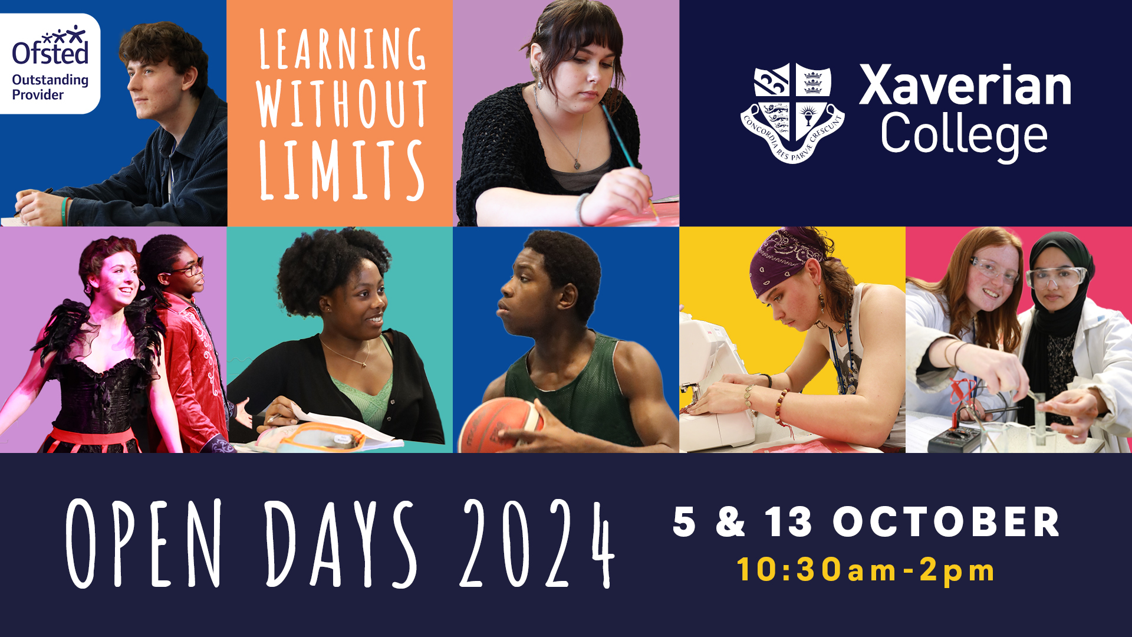

Slide 11
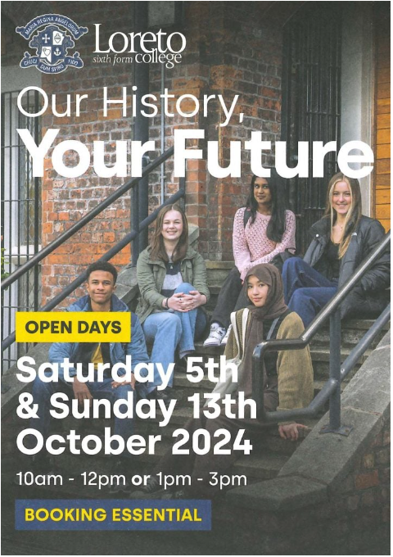

Slide 12


Slide 13


