Slide 1

College Open Events
2025 -2026

Slide 2
Check the college websites and register.
Visit as many colleges as possible to help make the best decision for you.

Slide 3

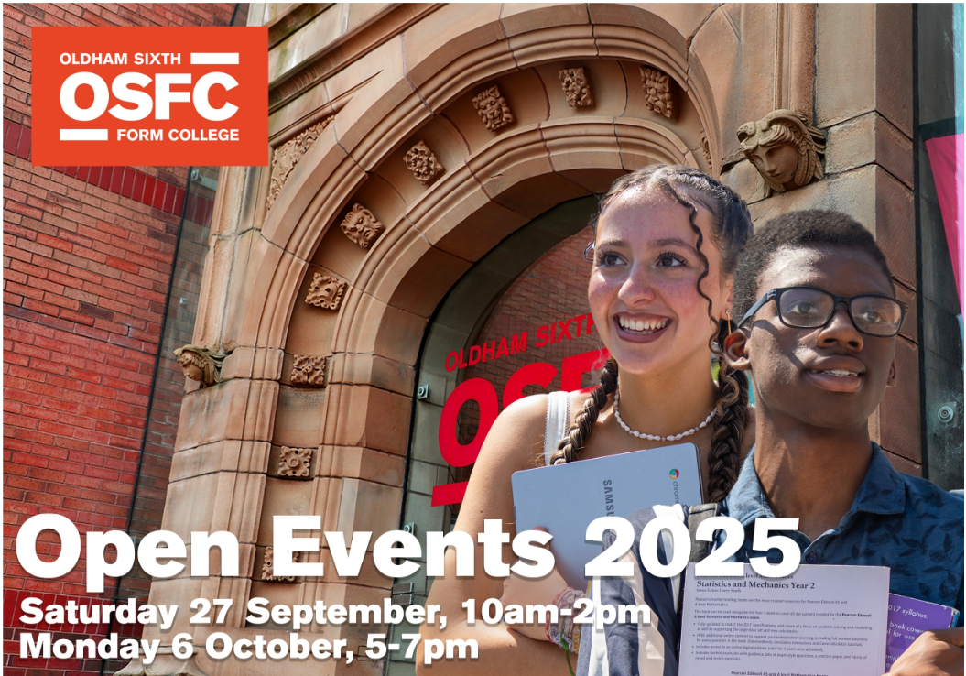

Slide 4

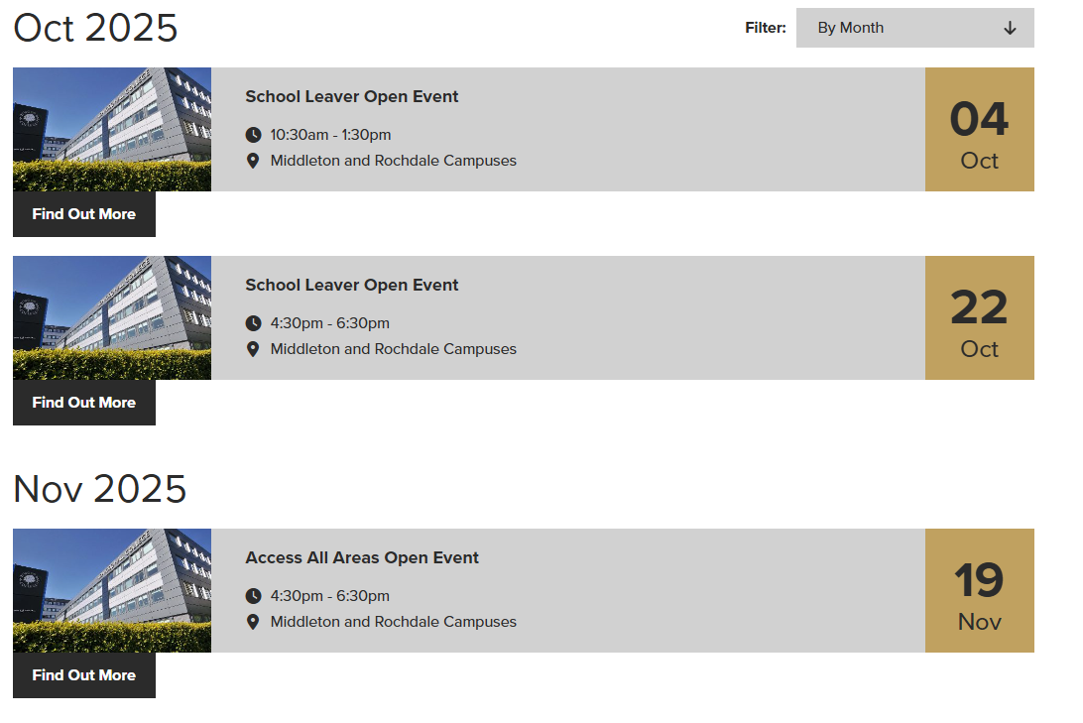
HOPWOOD HALL COLLEGE

Slide 5

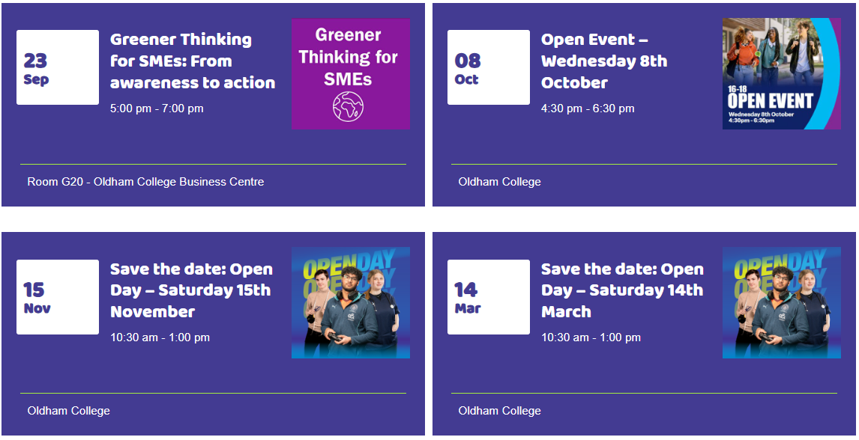
THE OLDHAM COLLEGE - VOCATIONAL COURSES

Slide 6



Slide 7

OPEN EVENTS
SATURDAY
15TH NOVEMBER 2025
PRIORITY DEADLINE FOR APPLICATIONS
MONDAY 17TH NOVEMBER 2025

Slide 8


Slide 9


Slide 10



Slide 11


Slide 12



Slide 13
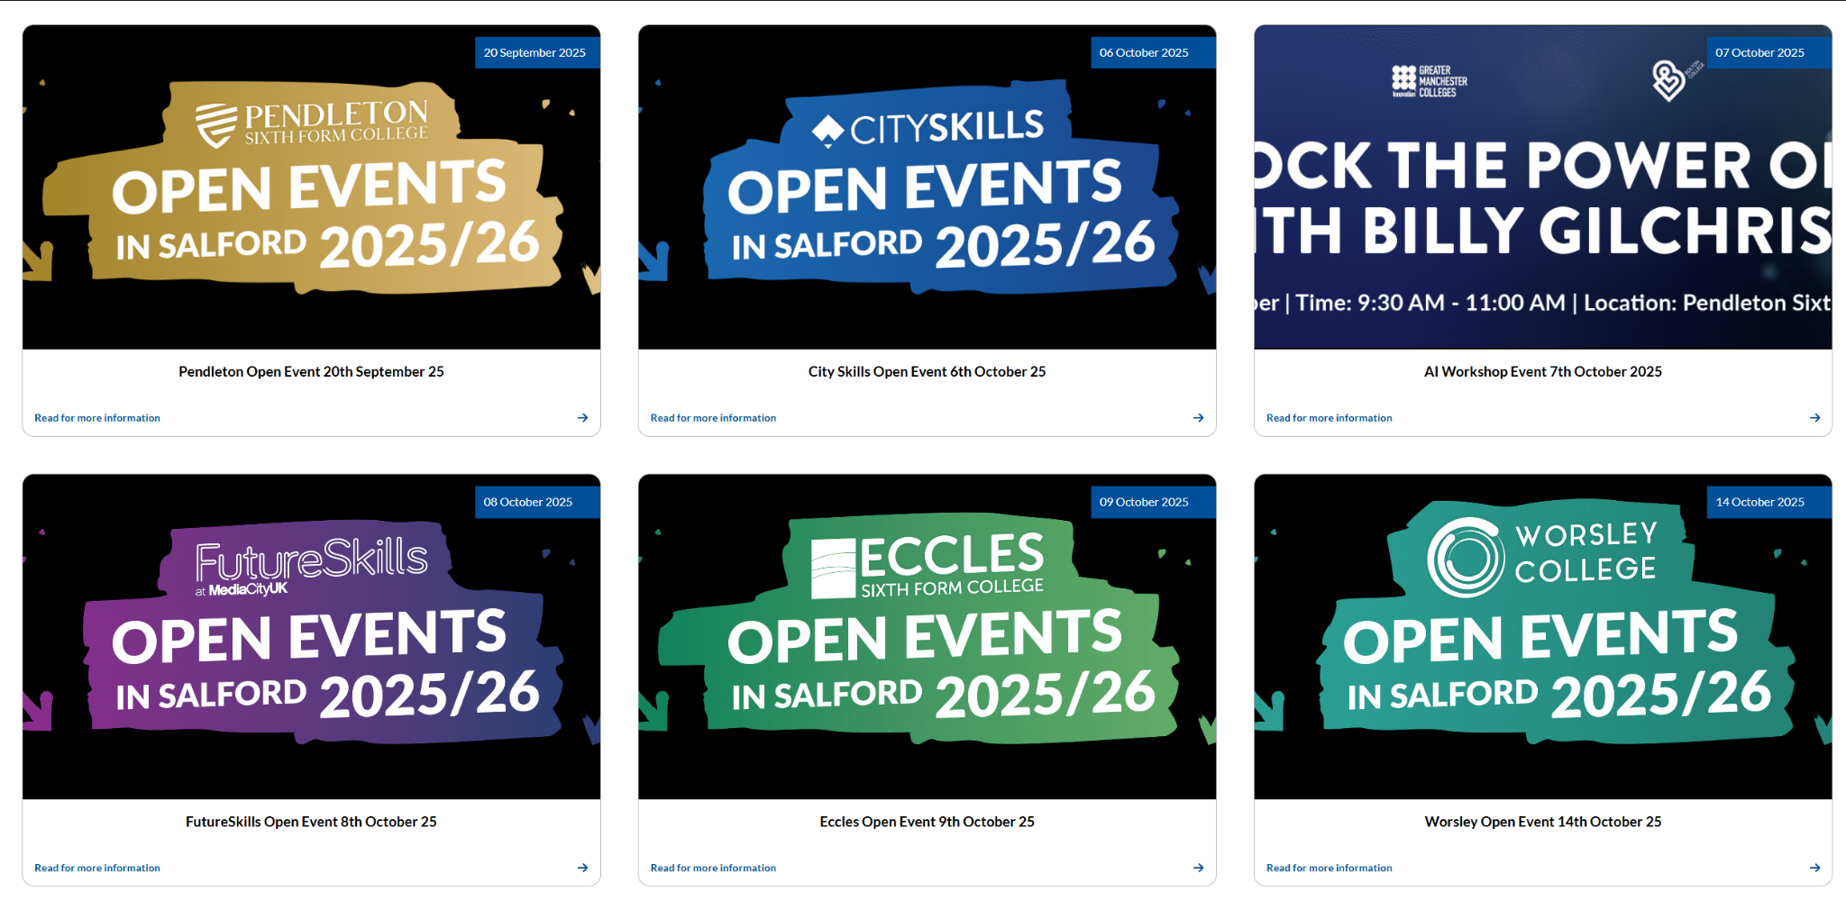

Slide 14


Visit our 16-18 Open Event on the 7th October 2025. Our Open Event is designed to give you a real insight into life at Bury College.

